Slide 1
Job Postings & Fortune 1000 Companies
By
Kalyan Praneeth Perala

Slide 2
Agenda
Theme of the project
Datasets and the cleaning
Questions and results interpretation

Slide 3
Theme of the project
What is the theme
Why this theme
Datasets that fit this theme

Slide 4
Datasets and cleansing
Job postings in indeed
Companies in fortune 1000
Combination of the datasets
Data Cleaning

Slide 5
Question 1
Which job type has more posting in fortune 1000 companies?
Data Set: Indeed and Fortune 1000 Combined
Test: Chi-Square Test of Independence.
Row Variable: Is fortune
Column Variables: Job Type (Data Analyst, Data Engineer, Data Scientist)

Slide 6
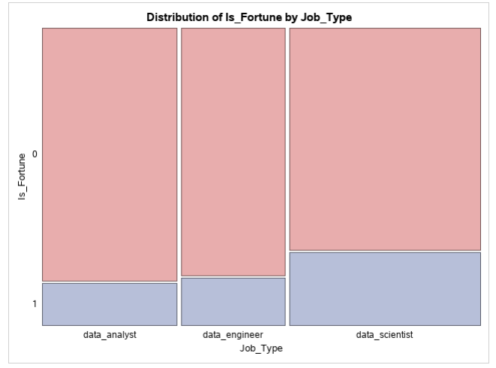
Result

Slide 7
Inferences
Chi square value = 87.7453
The P value is <.0001 which is less than the level of the significance 0.05. We conclude that we reject the null hypothesis and conclude that the job postings are dependent on fortune 1000 companies.
The job postings of fortune 1000 companies depend on job type and looking at the bar graph from the result in the appendix, we can state that data science role is most common job role for fortune 1000 and data analyst is most common role in non-fortune company.

Slide 8
Question 2
Which location has more postings of different job types?
Data Set: Indeed and Fortune 1000 Combined
Test: Chi-Square Test of Independence.
Row Variable: Job Type (Data Analyst, Data Engineer, Data Scientist)
Column Variables: Location

Slide 9
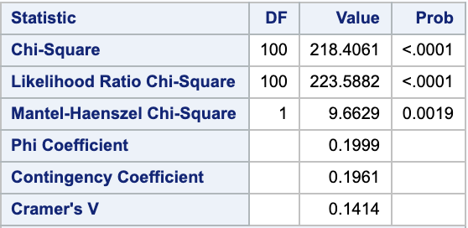
Result

Slide 10
Inference
Chi square value = 218.4061
The P value is <.0001 which is less than the level of the significance 0.05. We conclude that we reject the null hypothesis and conclude that the location is dependent on job type.
The job postings of different job types depend on location, and looking at the bar graph from the result in the appendix, we can state that data science, data engineer and data analyst job postings are more in CA, NY, VA, TX

Slide 11
Question 3
Is there any significant difference in salary level for each job type? JobType <- Salary Level (dependent)
Analysis: Chi square test of independence
JobID | Queried Salary | Salary level | Job_Type
1 | <80000 | 1 | data_scientist
2 | 80000-99999 | 2 | data_analyst
3 | 100000-119999 | 3 | data_scientist
4 | 120000-139999 | 4 | data_engineer
5 | 140000-159999 | 5 | data_analyst
6 | >160000 | 6 | data_engineer

Slide 12
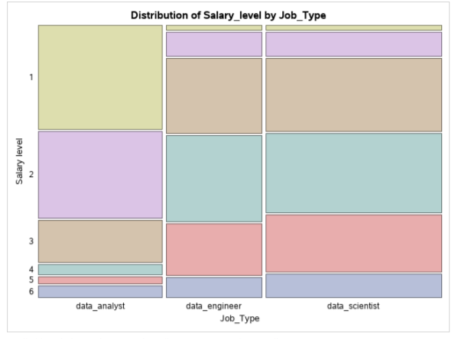
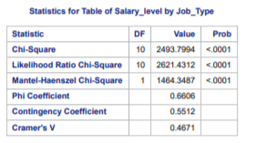
Result
Queried Salary | Salary level
<80000 | 1
80000-99999 | 2
100000-119999 | 3
120000-139999 | 4
140000-159999 | 5
>160000 | 6

Slide 13
Inference
Chi square value = 2493.7
The P value is <.0001, so job type and salary level are dependent
We see data scientist position to have relatively high pay and data analyst position to be on the lower pay level

Slide 14
Question 4
Is there any significant different in number of skills required for each job type? JobType->No.of skills
Analysis: Linear regression
data_scientist
data_engineer
data_analyst
JobID | Job_Type | No_of_Skills
1 | data_scientist | 12
2 | data_analyst | 14
3 | data_scientist | 13
4 | data_engineer | 8
5 | data_analyst | 20
6 | data_engineer | 7

Slide 15
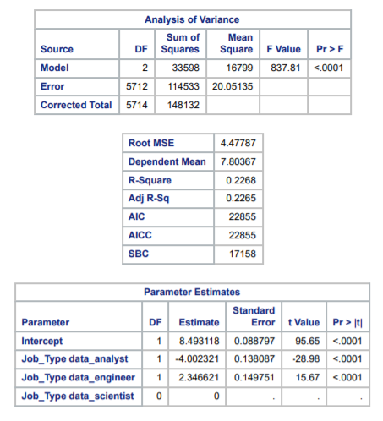
Result
Job Type | Skill | Pay
data_engineer | 2.3 | Med
data_scientist | ---- | High
data_analyst | -4 | Low

Slide 16
Inference
F value = 837.8
The P value is <.0001, so the model is significant
Data Engineer job requires 2.3 times more skill comparted to data scientist
Data Analyst job requires 4 times less skill comparted to data scientist

Slide 17
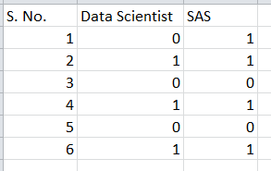
Question 5
Does knowing SAS effect the chances of being qualified for data scientist job?
Analysis: Binary logistic regression
Data set used: Indeed and fortune combined
Variables: y - Data scientist, x - SAS

Slide 18
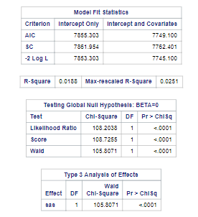

Result

Slide 19
Inference
The –2Log L values for only intercepts and intercepts with covariates is decreasing meaning that the model is a good fit.
The Wald’s Chi-Square value for the variable is 105.8071 and the p-value is <.0001
From the p-value, we can conclude that the skill “SAS” has a significant effect on the chances of being qualified for a data scientist job.
From the Odds ratio estimates table, we can infer that knowing SAS increases your chances for Data scientist by 52.7%

Slide 20
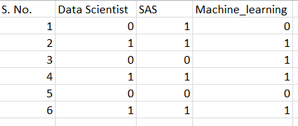
Question 6
Machine Learning influence on job posting for data scientist who already knows SAS?
Analysis: Moderation (binary logistic regression)
Data set used: Indeed and fortune combined
Variables: Y - Data scientist, x is SAS and m is Machine Learning

Slide 21
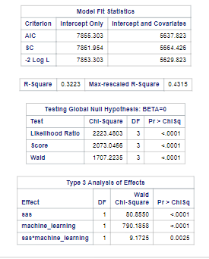
Result

Slide 22
Inference
The –2Log L values for only intercepts and intercepts with covariates is decreasing citing that the model is a good fit.
The p-value for the product of SAS and machine_learning is 0.0025
We can infer that the skill “Machine Learning” increases chances of a job posting for data scientist with existing knowledge of SAS.
The R square range for the model has significantly increased to 32.2-43.1% after the moderator is added.

Slide 23
Conclusion
Relevant Information.
Analysis that will aid to find your "dream" job.

Slide 24


